Slide 1
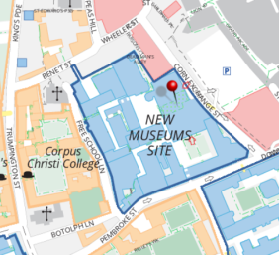
The Cambridge Centre for Environment, Energy, and Natural Resource Governance (C-EENRG) is hosting a weekly seminar series throughout the 2017-18 academic year. These are informal and friendly talks allowing discussion of on-going work for early career and senior researchers. Seminars take place every Thursday, 3-4pm, in room 2.49 at the David Attenborough Building. Convenors: Dr Tibisay Morgandi, Dr Maria Augusta Paim and Dr Pablo Salas.
18 Jan
25 Jan 1 Feb
15 Feb
Dr Christina Penasco, C-EENRG, University of Cambridge A market for green patents? Analysis of ownership changes in environmental technologies from Spain
Arthur Dalmarco, C-EENRG, University of Cambridge The Brazilian electricity sector: overview and perspectives for wind and solar energy
Mario Gilberto Aguilera Bravo, Lauterpacht Centre for International Law, University of Cambridge Public participation in environmental decisions: Europe and Latin America in comparative perspective
Prof Elisabeth Gsottbauer, Universität Innsbruck Coordination and inequalities in agglomeration payments: evidence from a laboratory experiment
Page 1 of 2

Slide 2
The Cambridge Centre for Environment, Energy, and Natural Resource Governance (C-EENRG) is hosting a weekly seminar series throughout the 2017-18 academic year. These are informal and friendly talks allowing discussion of on-going work for early career and senior researchers. Seminars take place every Thursday, 3-4pm, in room 2.49 at the David Attenborough Building. Convenors: Dr Tibisay Morgandi, Dr Maria Augusta Paim and Dr Pablo Salas.
22 Feb
1 Mar
8 Mar
Dr Rachel Carmenta, UCCRI, University of Cambridge
Stakeholder perceptions across scales of governance: areas of controversy and consensus related to the Indonesian peatland fires
Dr Tibisay Morgandi, SNSF Postdoctoral Fellow, CEENRG, University of Cambridge
Around the world in 605 State energy agreements
Prof Thiago Fonseca Morello, CECS, Universidade Federal do ABC, Brazil
Fire, tractors and health in the Amazon: a cost-benefit analysis of fire policy based in stated preferences
Page 2 of 2

